Slide 1
What You Need to Know About Financial Aid
Presented by:
Melissa Moland, Associate Director of Financial Aid
Office of Financial Aid
Christopher Newport University

Slide 2
Topics We Will Discuss Tonight
What is financial aid?
Cost of attendance (COA)
Expected family contribution (EFC)
Financial need
Types and sources of financial aid
Free Application for Federal Student Aid (FAFSA)
Special circumstances

Slide 3

What is Financial Aid?
Financial aid consists of funds provided to students and families to help pay for postsecondary educational expenses.

Slide 4
What is Cost of Attendance (COA)?
Direct costs
Indirect costs
Direct and indirect costs combined into cost of attendance
Varies widely from college to college

Slide 5
What is Expected Family Contribution (EFC)?
Amount family can reasonably be expected to contribute
Stays the same regardless of college
Two components:
  Parent contribution
  Student contribution
Calculated using data from a federal application form and a federal formula

Slide 6
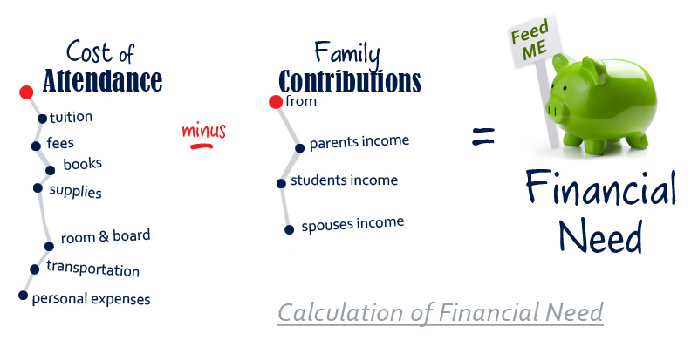
What is Financial Need?

Slide 7
Types of Financial Aid
Scholarships
Grants
Loans
Employment
Gift Aid
Self-Help Aid

Slide 8
Gift Aid: Scholarships
Money that does not have to be paid back.
Awarded on the basis of merit, skill, or unique characteristic.

Slide 9
Gift Aid: Grants
Money that does not have to be paid back.
Usually awarded on the basis of financial need.

Slide 10
Self-Help Aid: Loans
Money students and parents borrow to help pay college expenses.
Repayment usually begins after education is finished.
Only borrow what is really needed.
Look at loans as an investment in the future.

Slide 11
Self-Help Aid: Federal Work-Study Employment
Allows student to earn money to help pay educational costs.
  A paycheck directly to the student that is most commonly used towards indirect costs.
Student may opt whether or not to work or number of hours to work.

Slide 12
Sources of Financial Aid
Federal government
States
Colleges and universities
Private sources
Civic organizations and churches
Employers

Slide 13
Federal Government
Largest source of financial aid
Aid awarded primarily on the basis of financial need
Must apply each year using the FAFSA

Slide 14
Federal Student Aid Programs
Federal Pell Grant
Teacher Education Assistance for College and Higher Education (TEACH) Grant
Federal Supplemental Educational Opportunity Grant (FSEOG)
Federal Work-Study (FWS)
Subsidized and Unsubsidized Federal Direct Student Loans (Direct Loans)
Parent PLUS Loans

Slide 15
States
Residency requirements usually apply.
Award aid on the basis of both merit and need.
Use information from the FAFSA and/or state aid applications.
Deadlines vary by state
  Check FAFSA on the Web website
  Check with each college or university
  CNU Financial Aid Deadlines:
  Preferred Filing Date: December 15, 2017
  Priority Filing Deadline: March 1, 2018

Slide 16
Colleges and Universities
Award aid on the basis of both merit and need
Aid may be gift aid or self-help aid
Use information from the FAFSA and/or institutional applications
Deadlines and application requirements vary by institution
  Check with each college or university.

Slide 17
Private Sources
Foundations, businesses, charitable organizations
Deadlines and application procedures vary widely
Begin researching private aid sources early

Slide 18
Civic Organizations and Churches
Research what is available in community
To what organizations and churches do student and family belong?
Application process should be ongoing during high school years
Small scholarships add up!

Slide 19
Employers
Companies may have scholarships available to the children of employees.
Companies may have educational benefits for their employees.

Slide 20
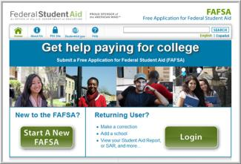
How to Apply
Complete the electronic FAFSA internet application used by students and parents at:
www.fafsa.gov
Sophisticated on-line edits and skip logic help avoid errors.
On-line help is available for each question.
Student and one custodial parent should get an FSA ID to sign FAFSA at:
fsaid.ed.gov

Slide 21
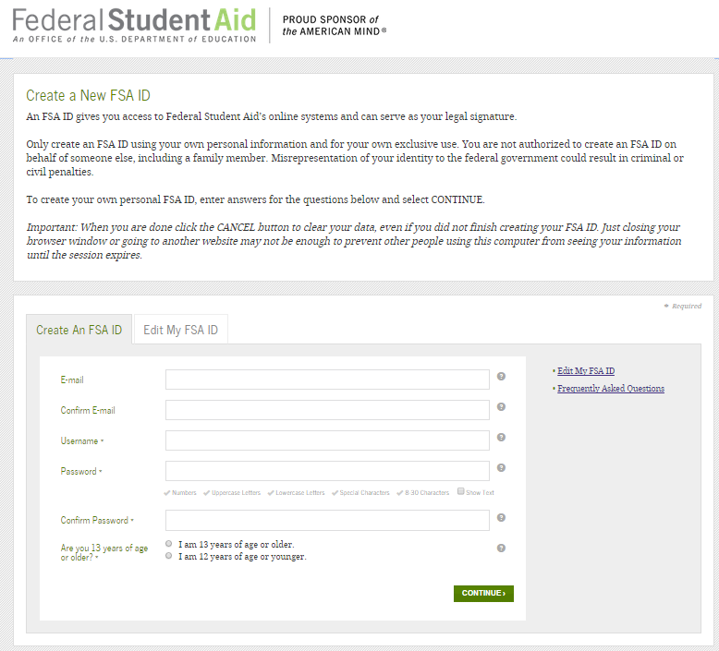
FSA ID
The FSA ID is your electronic signature.
The student and at least one custodial parent will be required to create an FSA ID, made up of a username and password, to access and sign the FAFSA electronically.
Apply through the FSA ID link on the FAFSA website: www.fafsa.gov.
Have the following information ready:
Name
Social Security Number
Date of Birth
Email address
The information will be run through a match with the Social Security Administration so the name and social MUST match the SSA records.

Slide 22

FAFSA Information & Tips
File early, beginning October 1, 2017.
Use 2016 financial and tax information for the 2018/2019 FAFSA.
Meet each school’s priority filing deadline that the student applies for admission.
Student and at least one parent whose information is reported must complete and sign the FAFSA with an FSA ID.
FAFSA must be submitted each year for aid.

Slide 23




Getting Ready
Before starting the FAFSA on the Web (FOTW), gather:
  Student driver’s license
  Student Alien Registration Card, if applicable
  Student and Parent
    Social Security numbers
    2016 W-2 Forms and records of money earned and other taxable benefits
    2016 federal income tax form
    Records of 2016 untaxed income
    Current bank statements
    Business, farm, and other real estate records
    Records of stocks, bonds, and other investments
Create a file for copies of all financial aid documents submitted

Slide 24
The FAFSA Breakdown
Section 1 – Student Demographics
Section 2 – School Selection
Section 3 – Dependency Status
Section 4 – Parent Demographics
Section 5 – Financial Information
Section 6 – Sign and Submit
Section 7 – Confirmation

Slide 25
FAFSA on the Web
Benefits of filing electronically:
Built-in edits to prevent costly errors
Skip-logic allows student and/or parent to skip unnecessary questions
Option to use Internal Revenue Service (IRS) Data Retrieval Tool to import tax data

Slide 26
FAFSA on the Web
Benefits of filing electronically:
More timely submission of original application and any necessary correction.
More detailed instructions and “help” for common questions.
Ability to check application status online.
Simplified application process in the future.

Slide 27
IRS Data Retrieval Tool
While completing FOTW, applicant may submit real-time request to IRS for tax data.
IRS will authenticate taxpayer’s identity.
If match is found, IRS sends real-time results of what financial information was filed.
Applicant chooses whether or not to transfer data to FOTW.

Slide 28
IRS Data Retrieval Tool
Some will be unable to use IRS DRT
Examples include:
  No Social Security Number (SSN) was entered
  Student or parent married but filed separately

Slide 29
What Happens Next?
Students and the colleges the student listed receive Student Aid Report (SAR) from federal processor in 10-14 business days.
Students and families review SAR for important information and accuracy of data.
Colleges match admission records with FAFSA and other required financial aid forms to determine aid eligibility.
Colleges provide notices of financial aid eligibility to admitted students who have completed all required financial aid forms.

Slide 30
Federal Verification
Some students may be required to verify the information reported on the FAFSA.
If selected for verification, the tax information of federal tax filers will be verified through:
  The IRS Data Retrieval Process, or
  IRS Tax transcripts if requested by the college or university
Non-tax filers selected for verification may be asked to provide:
  Non-tax Filer’s statement
  Copies of W-2s or other income documentation from each employer , if any income was earned from work
Selected aid applicants will also be asked to verify certain demographic data listed such as:
  Household size and number in college
  Child support paid and untaxed income, if reported on the FAFSA

Slide 31
Special Circumstances
Cannot be documented using FAFSA
Send written explanation and documentation to financial aid office at each college
College will review and request additional information if necessary
Decisions are final and cannot be appealed to U.S. Department of Education

Slide 32
Examples of Special Circumstances
Change in employment status
Unusual medical expenses not covered by insurance
Change in parent marital status
Unusual dependent care expenses
Student cannot obtain parental information due to extenuating circumstances

Slide 33
Meeting the Cost after the FAFSA
Don’t assume your FAFSA financial aid package will cover the full cost of attendance at every school. Plan ahead and understand all of your options.
Research the total cost of each school early
Compare the bottom line – not just the total amount of aid offered
  How much of the package includes loans?
  What are the out-of-pocket expenses after aid is applied?
Scholarships are EXTREMELY important – never stop applying
  It is important to have external resources in place such as college savings plans and external scholarships.
Understand your options for covering the cost difference
  Payment Plans
  Parent PLUS and/or Private Loans

Slide 34
Important Notes
File the FAFSA 2018/2019 FAFSA as soon as October 1, 2017.
Submit all required forms, including the FAFSA, by each college’s published deadlines.
Start the scholarship search early.
Keep a copy of all forms submitted.
Watch for financial aid award notification for incoming freshman by e-mail or mail from each school.

Slide 35
Resources
Federal Student Aid: https://studentaid.ed.gov/sa/
Annual Scholarship Fair and Online Search: www.scholarshipsharing.org
FSA ID: https://fsaid.ed.gov/npas/index.htm
FAFSA on the Web (FOTW) Live Help: https://fafsa.ed.gov/

Slide 36
Questions?

